Slide 1


Slide 8

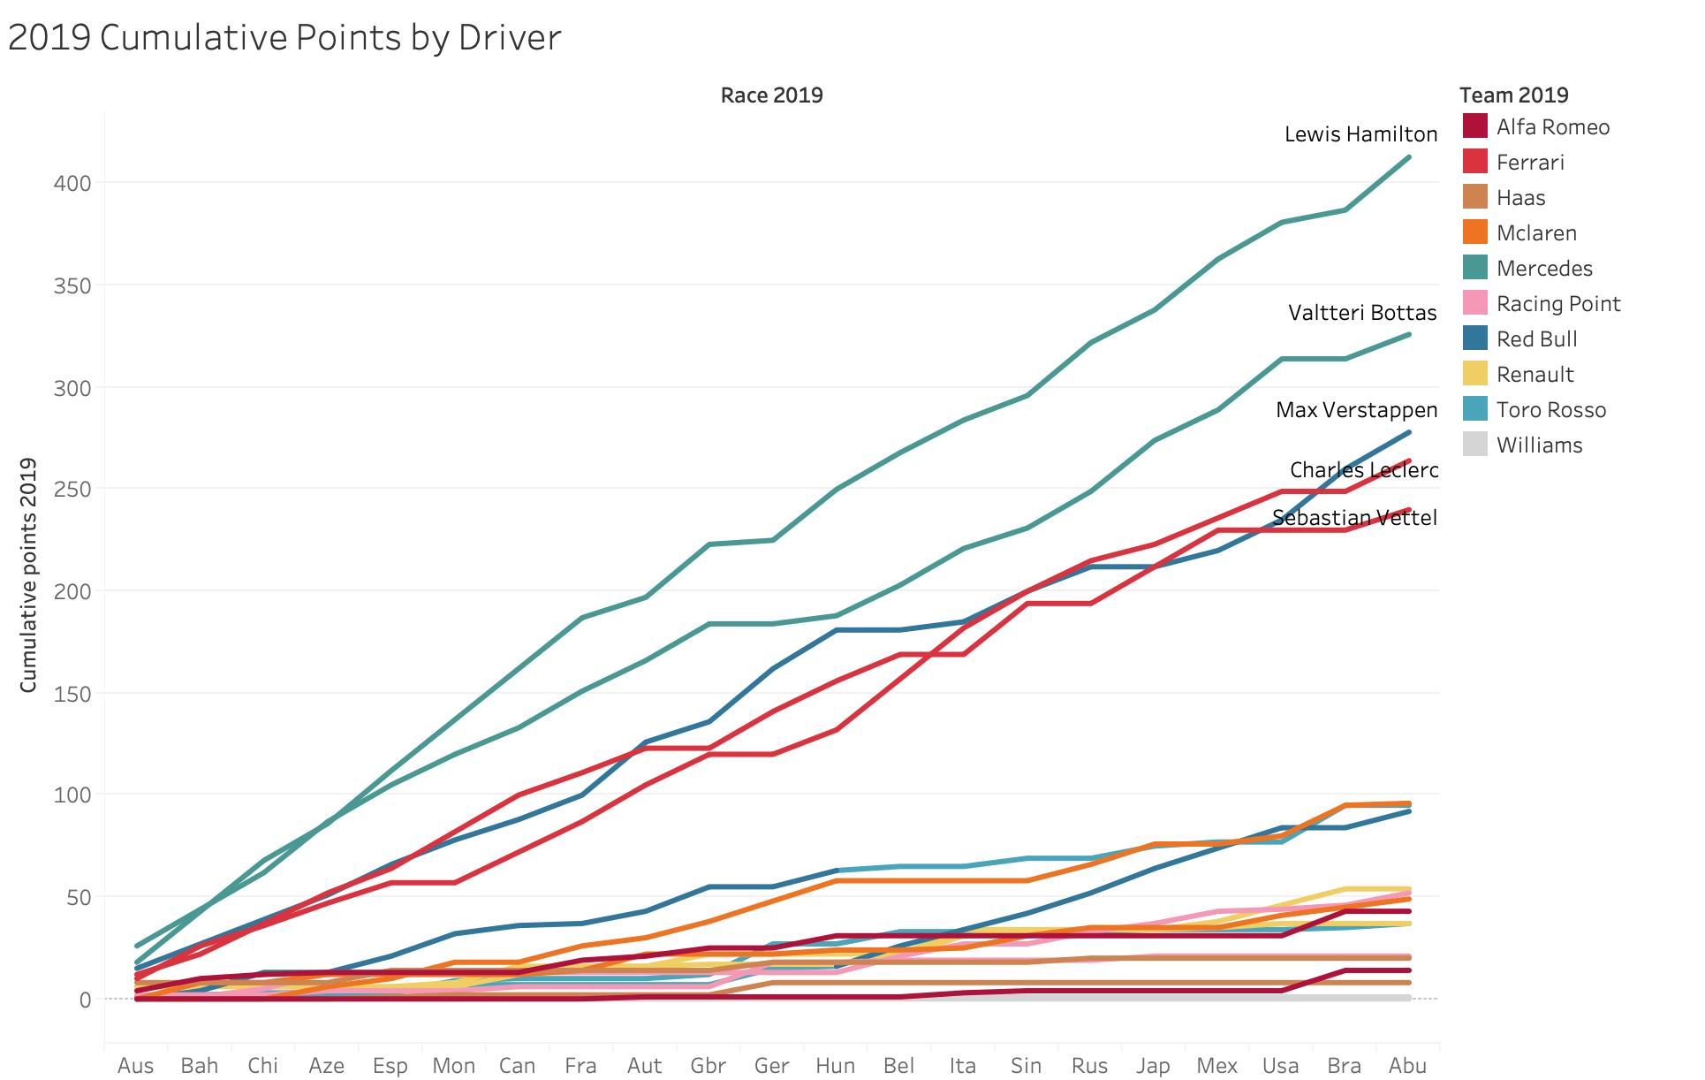

News site
Statistics

Slide 9
News site
Statistics

Slide 10
Statistics
News site
Season news and informations
Tech news
Community forum

Slide 11
Technology Stack
Structure
Function
Statistics
Historical statistics about F1
Easier search with AI
News site
Season news and informations
Tech news
Community forum

Slide 12





Technology Stack
Structure
Function
HTML5
CSS3
JavaScript
NodeJS
MYSQL
Statistics
Historical statistics about F1
Easier search with AI

Slide 13
Technology Stack
Structure
Function
Localhost: 3000
HUB
Localhost: 3001
Statistics
Localhost: 3002
News site

Slide 14

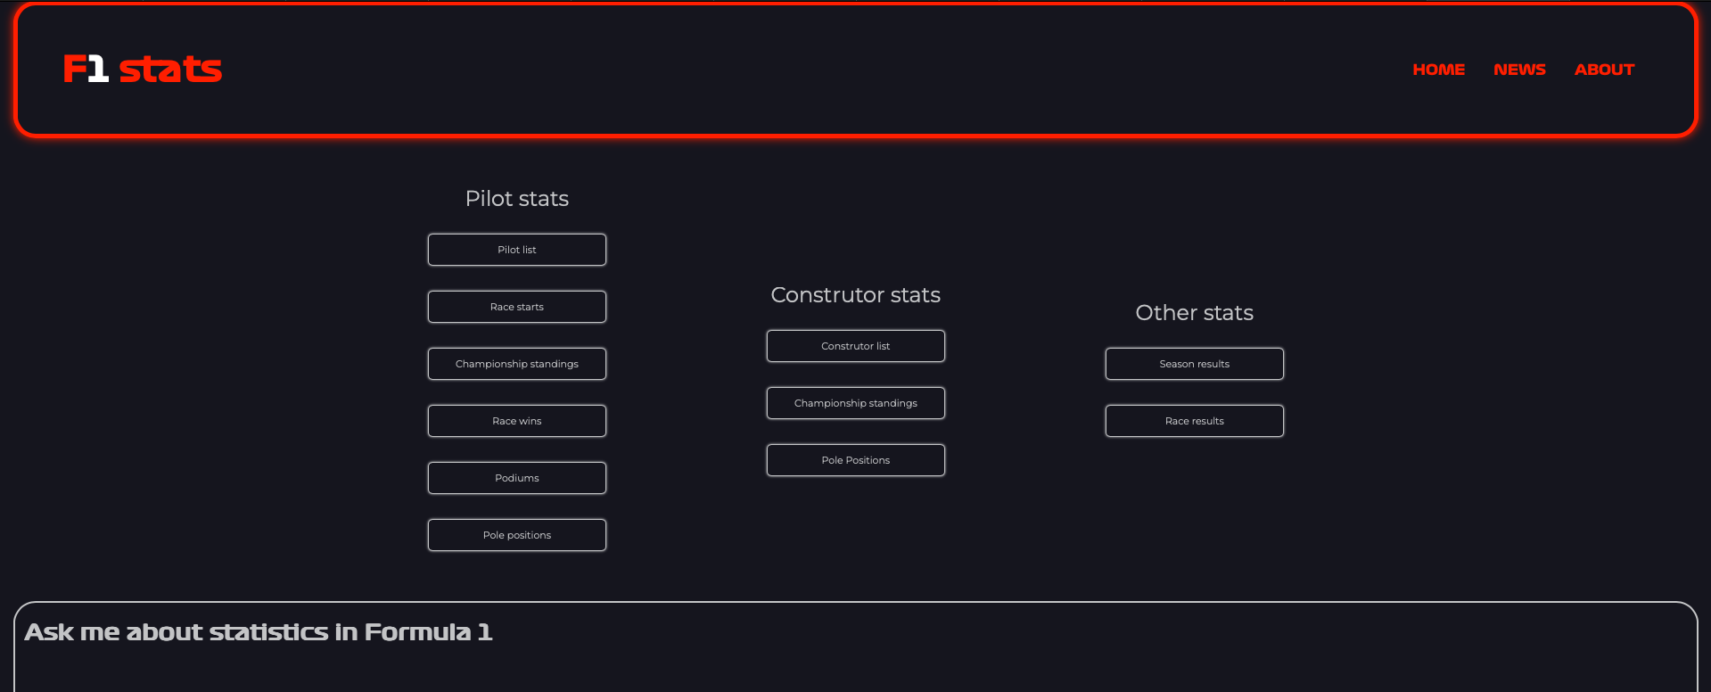
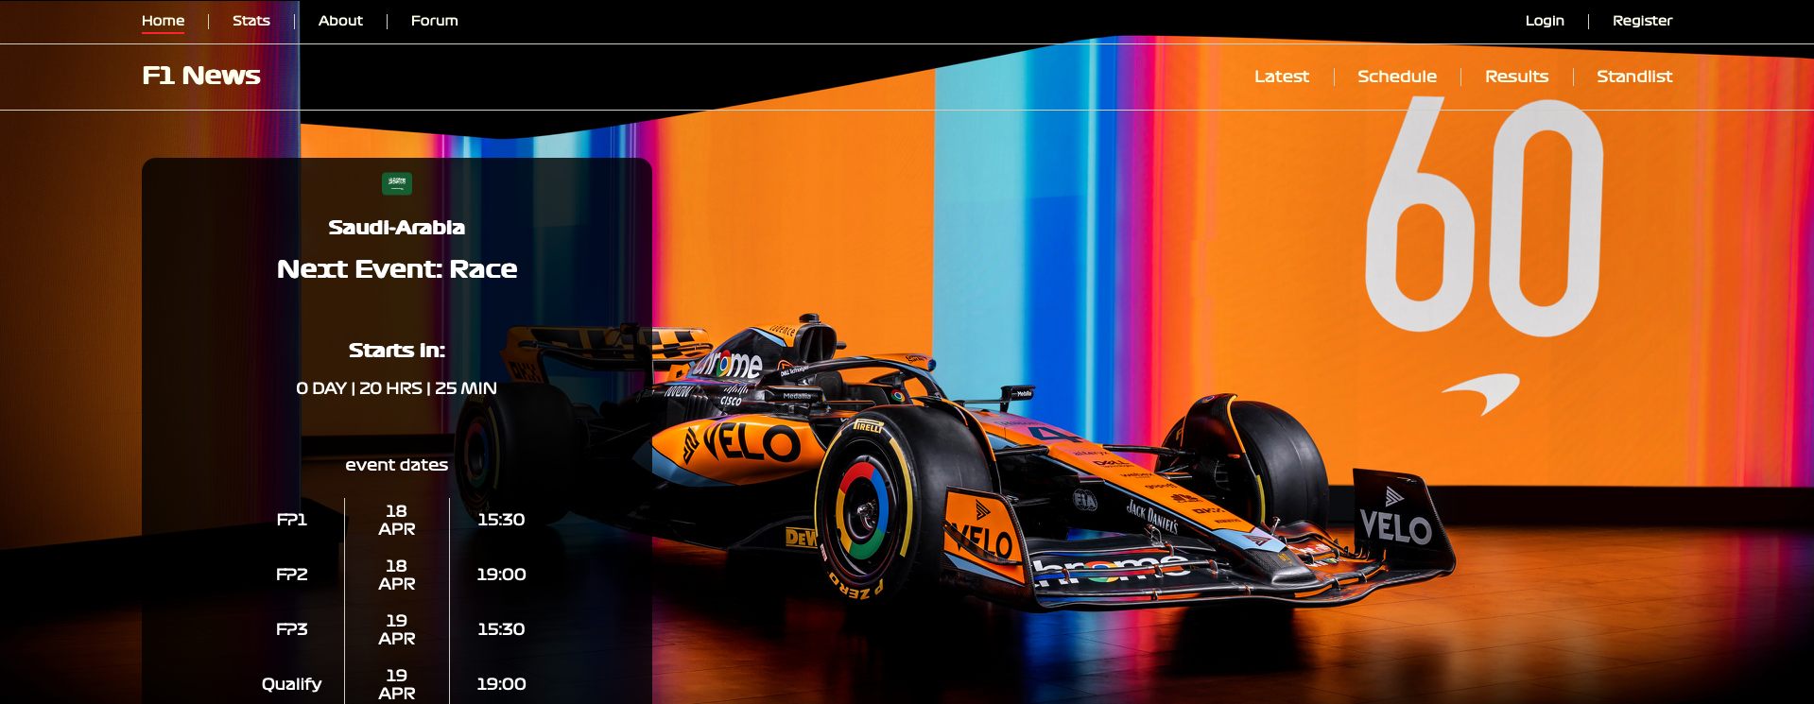
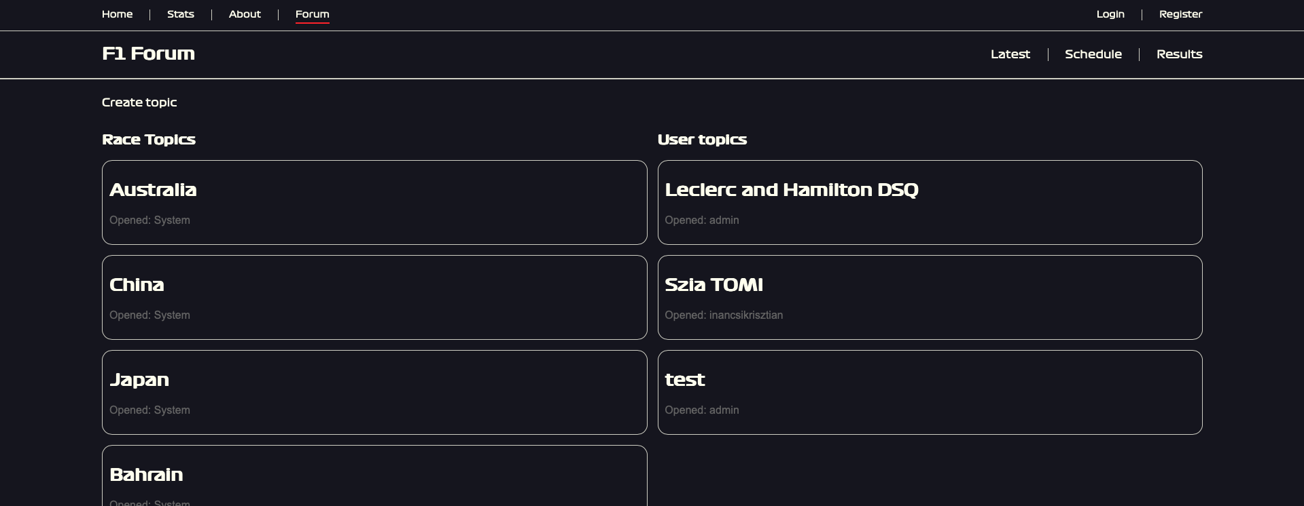
Fábián Tamás
Ináncsi Krisztián
HUB client
Statistics page
Web server
Technology Stack
Structure
Function
HUB client starts
Starts the other clients
Connecting to the databases
Calling API endpoints
JavaScript displays the data

Slide 15
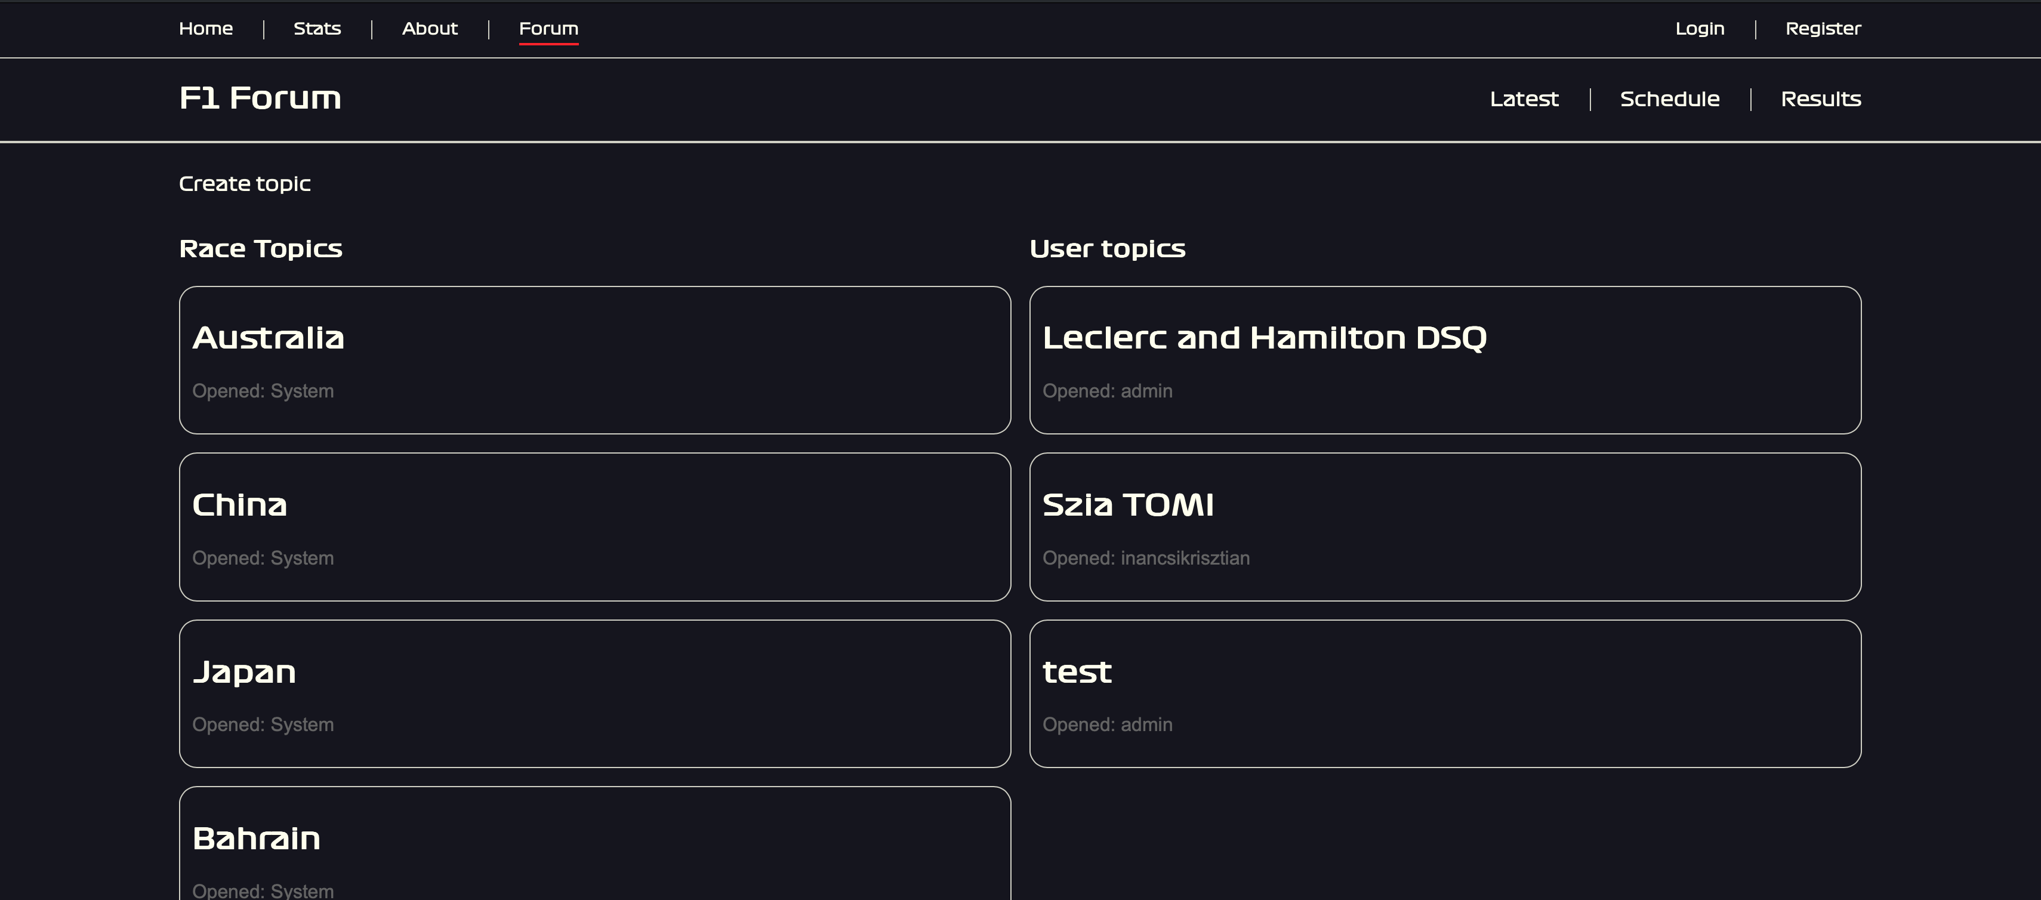
Fábián Tamás
Ináncsi Krisztián
HUB client
Statistics page
Web server
Technology Stack
Structure
Function
HUB client starts
Starts the other clients
Connecting to the databases
Calling API endpoints
JavaScript displays the data

Slide 16
Fábián Tamás
Ináncsi Krisztián
Bartók Krisztián
HUB client
News site functions
Statistics page
Forum and login integration
Web server
Statistics & News page style

Slide 17
Ináncsi Krisztián
Bartók Krisztián
News site functions
Databases
Forum and login integration
Login & Register methods
Statistics & News page style
Forum site

Slide 18
Thank you for your attention!
Sources
Path to the page
W3Schools
f1statsandnews.com
Stack Overflow
Formula 1 Official website
Wikipedia

